Slide 1
Agenda
OAuth Concepts
Programming OAuth

Slide 2
OAuth Concepts

Slide 3
What is OAuth 2.0?
Simple mechanism to grant a third party access to a user’s resources without sharing the user’s password.
Cross platform app authorization
Internet Standard supported by Azure, Facebook, Google, Twitter, and more
Notes:
OAuth provides a simple mechanism for end-users to grant a third party access to their data and resources without sharing their passwords.
It also enables the user to grant access limited by scope and duration.

Slide 4
OAuth 2.0 Tokens
Context Token
Information about the Resources Owner and Client that can be used to get an Access Token later.
Refresh Token
A token used to get an Access Token from the Authorization Server.
Access Token
A token passed to the Resource Server authorizing the Client to access resources.
Authorization Code
A code that can be used to register an app on-the-fly.
Notes:
In the OAuth 2.0 model, access to protected resources is done using access tokens —an object with a specific scope, lifetime, and other access attributes. OAuth access tokens are sometimes compared to valet keys. In the same way as a valet key gives restricted access to a car, allowing a valet to drive it but not open the trunk or the glove compartment, the access token allows a client application restricted access to a user’s data at a resource server via tokens issued by an authorization server in response to the user authorizing access.
With OAuth 2.0, a third-party application does not use the resource owner's credentials to access protected resources. Instead, the third-party application obtains an access token. Access tokens are issued to third-party clients by an authorization server with the approval of the resource owner. The client uses the access token to access the protected resources hosted by the resource server.
Nik:
Context Token is a JWT formatted token. It contains various claims, including information about the Authentication Service (ACS) and the Refresh Token

Slide 5
App Principals
Apps must be registered with SharePoint online
Client ID – generated during the registration process
Client Secret – generated during the registration process
App Host Domain – the domain of the Azure web site hosting the app
Redirect URL – the URL of the return page after permissions are granted
SharePoint provides registration management pages
AppRegNew.aspx – for registering a new app
AppInv.aspx – for updating registered apps
AppPrincipals.aspx – lists all registered apps
Notes:
Apps are first-class principals in SharePoint
They have an identifier and permissions, which are tracked in SharePoint through the registration and installation process

Slide 6
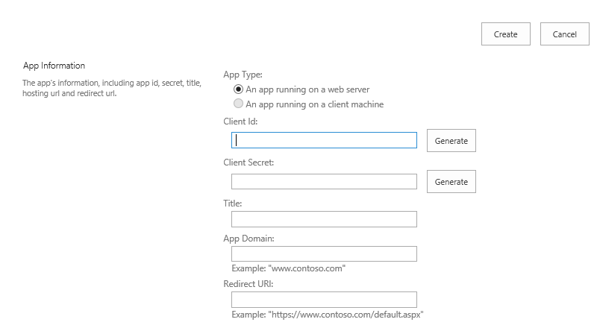
Registering a New App
Generated value
Generated value
Free text value
Azure domain (e.g., myapp.azurewebsites.net)
Web address (e.g., https://myapp.azurewebsites.net)
Notes:
Apps must be registered with SharePoint. This page will generate a new client ID and secret for the app. If deployed to Azure, use that information to fill out the rest of the form.

Slide 7
Provider-Hosted App Flow Scenario
User has Organizational Account
App registered with SharePoint Online
App deployed to SharePoint Online
Remote Web deployed as an Azure Website
Client ID and Client Secret defined in AAD
Notes:
Nik:
Organizational Account: User has an account on the Office 365 tenant;

Slide 8




OAuth 2.0 Flow Provider-Hosted App
Azure Web Site
(Client)
End User
(Resource Owner)
Azure ACS
(Authorization Server)
SharePoint Online
(Resource Server)

Slide 9
OAuth 2.0 Flow Provider-Hosted App
Azure Web Site
(Client)
End User
(Resource Owner)
User launches app
Azure ACS
(Authorization Server)
SharePoint Online
(Resource Server)

Slide 10
OAuth 2.0 Flow Provider-Hosted App
Azure Web Site
(Client)
End User
(Resource Owner)
Request Context token
for user
Azure ACS
(Authorization Server)
SharePoint Online
(Resource Server)

Slide 11
OAuth 2.0 Flow Provider-Hosted App
Azure Web Site
(Client)
End User
(Resource Owner)
Context Token returned
Azure ACS
(Authorization Server)
SharePoint Online
(Resource Server)

Slide 12
OAuth 2.0 Flow Provider-Hosted App
Azure Web Site
(Client)
Context Token returned
and user redirected to app
End User
(Resource Owner)
Azure ACS
(Authorization Server)
SharePoint Online
(Resource Server)

Slide 13
OAuth 2.0 Flow Provider-Hosted App
Azure Web Site
(Client)
End User
(Resource Owner)
App extracts Refresh Token
from Context Token
Azure ACS
(Authorization Server)
SharePoint Online
(Resource Server)

Slide 14
OAuth 2.0 Flow Provider-Hosted App
Azure Web Site
(Client)
App requests Access Token
using refresh Token
End User
(Resource Owner)
Azure ACS
(Authorization Server)
SharePoint Online
(Resource Server)

Slide 15
OAuth 2.0 Flow Provider-Hosted App
Azure Web Site
(Client)
Access Token returned
End User
(Resource Owner)
Azure ACS
(Authorization Server)
SharePoint Online
(Resource Server)

Slide 16
OAuth 2.0 Flow Provider-Hosted App
Azure Web Site
(Client)
End User
(Resource Owner)
Access Token presented
Along with request
Azure ACS
(Authorization Server)
SharePoint Online
(Resource Server)

Slide 17
OAuth 2.0 Flow Provider-Hosted App
Azure Web Site
(Client)
End User
(Resource Owner)
Response returned
Azure ACS
(Authorization Server)
SharePoint Online
(Resource Server)

Slide 18
Programming OAuth

Slide 19
SharePointContextProvider Class
Checks for valid Context Token
Redirects if it does not exist
Simplifies the management of context
Provides an ACS or STS context
Context exposes properties for key values like Host Web URL
Simplifies the management of tokens
Context exposes methods to retrieve tokens
Notes:
The SharePointContextProvider simplifies the management of context, and tokens
It uses a cookie to store the CacheKey, and stores the actual token in session state on the server referenced by the cache key
All of this improves performance and makes programming easier

Slide 20
SharePointAcsContext Class
Inherits SharePointContext
Provides specific properties and methods for dealing with context and access tokens
CSOM
CreateAppOnlyClientContextForSPAppWeb
CreateAppOnlyClientContextForSPHost
CreateUserClientContextForSPAppWeb
CreateUserClientContextForSPHost
REST
AppOnlyAccessTokenForSPAppWeb
AppOnlyAccessTokenForSPHost
UserAccessTokenForSPAppWeb
UserAccessTokenForSPHost
Notes:
Abstracts the management of tokens to make it easier

Slide 21
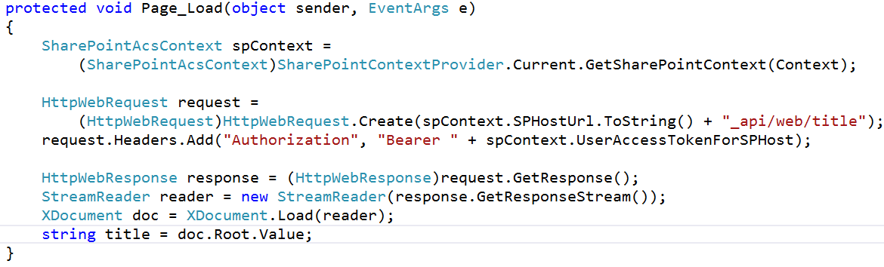
Making REST Calls with OAuth

Slide 22
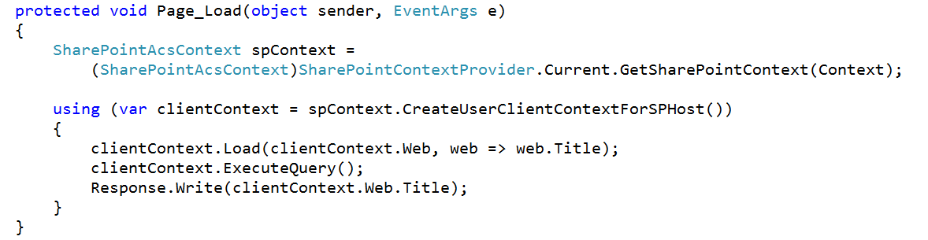
Making CSOM Calls with OAuth

Slide 23
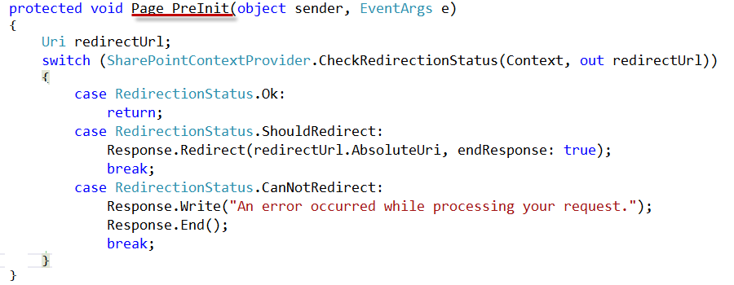
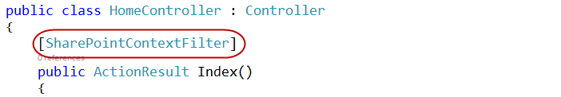
Validating Context Token
Web Forms
MVC 5
Notes:
ASP.NET Web Forms uses the PreInit method to validate the Context Token
Notice how it will redirect if the token is not valid
ASP.NET MVC 5 uses a filter to run essentially the same code
Notice how the filter attribute is applied to the controller

Slide 24
Managing SharePoint Context
SharePointContextProvider GetSharePointContext
Returns SharePointAcsContext in cloud
Returns SharePointHighTrustContext on premises
Properties
SPAppWebUrl
SPClientTag
SPHostUrl
SPLanguage
SPProductNumber
Notes:
SharePointAcsContext and SharePointHightTrustContext both inherit from SharePointContext
This means that the same code works in both cloud and on-premises environments

Slide 25
Managing Security Tokens
CSOM
CreateAppOnlyClientContextForSPAppWeb
CreateAppOnlyClientContextForSPHost
CreateUserClientContextForSPAppWeb
CreateUserClientContextForSPHost
REST
AppOnlyAccessTokenForSPAppWeb
AppOnlyAccessTokenForSPHost
UserAccessTokenForSPAppWeb
UserAccessTokenForSPHost
Notes:
The SharePointContext makes it easy to get the tokens you need

Slide 26
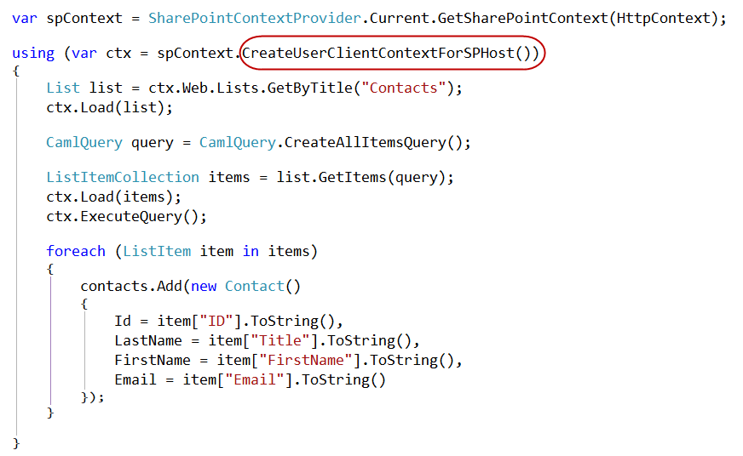
Managed CSOM

Slide 27
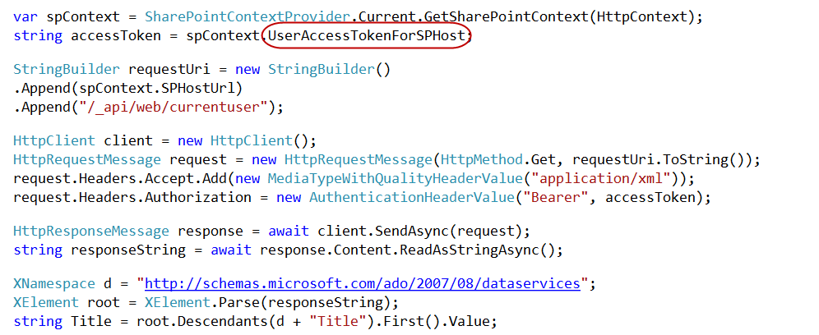
Managed REST

Slide 28
Lab #3 – Exercise 1 Task 2

